Slide 1
Welcome to AIX Tool
Please provide/load the below inputs
Upload the model in (pkl.format)
Browse
Enter the train data (csv/excel)
Browse
Enter the test data (csv/excel)
Browse

Slide 2
AIX Tool
Select a module
Model Explainer
Fairness Estimator

Slide 3
AIX Tool
Select a module
Model Explainer
Fairness Estimator

Slide 4
Model Explainer
Summary/Global Feature Importance
Violin Plot/Global Feature Interactions
PDP Plots/Inter feature dependencies
Force Plot/Local Feature Interactions
Choose a functionality to explore

Slide 5
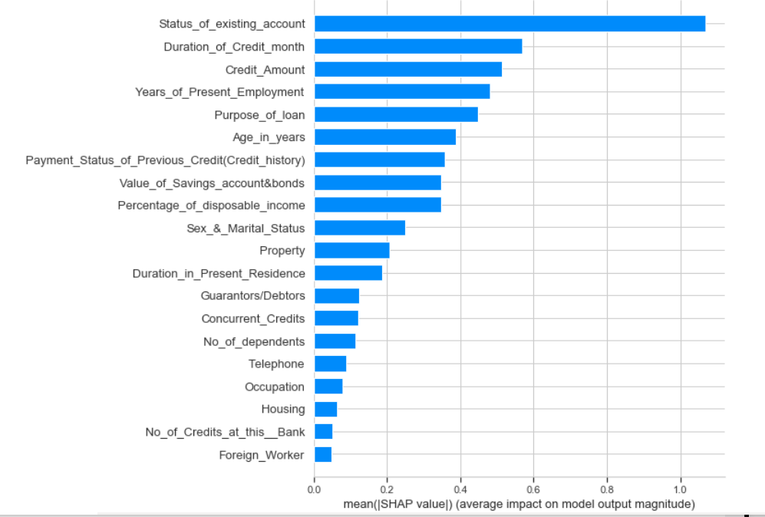
Model Explainer
Summary/Global Feature Importance
Violin Plot/Global Feature Interactions
PDP Plots/Inter feature dependencies
Force Plot/Local Feature Interactions
Class wise feature contribution on
Class wise feature contribution off

Slide 6
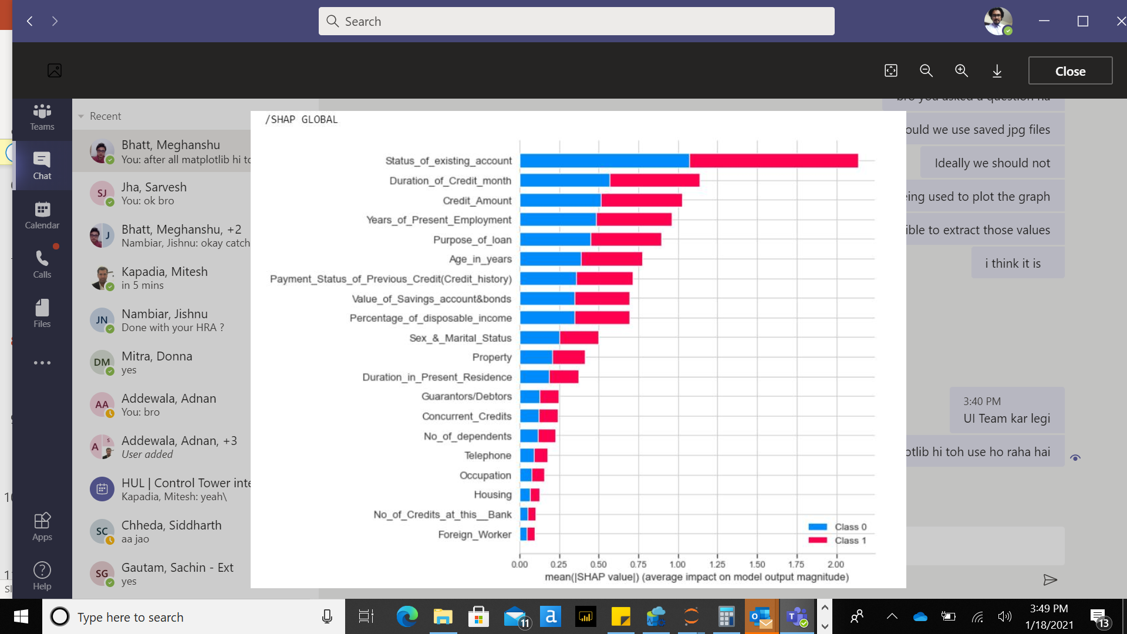
Model Explainer
Summary/Global Feature Importance
Violin Plot/Global Feature Interactions
PDP Plots/Inter feature dependencies
Force Plot/Local Feature Interactions
Class wise feature contribution on
Class wise feature contribution off

Slide 7
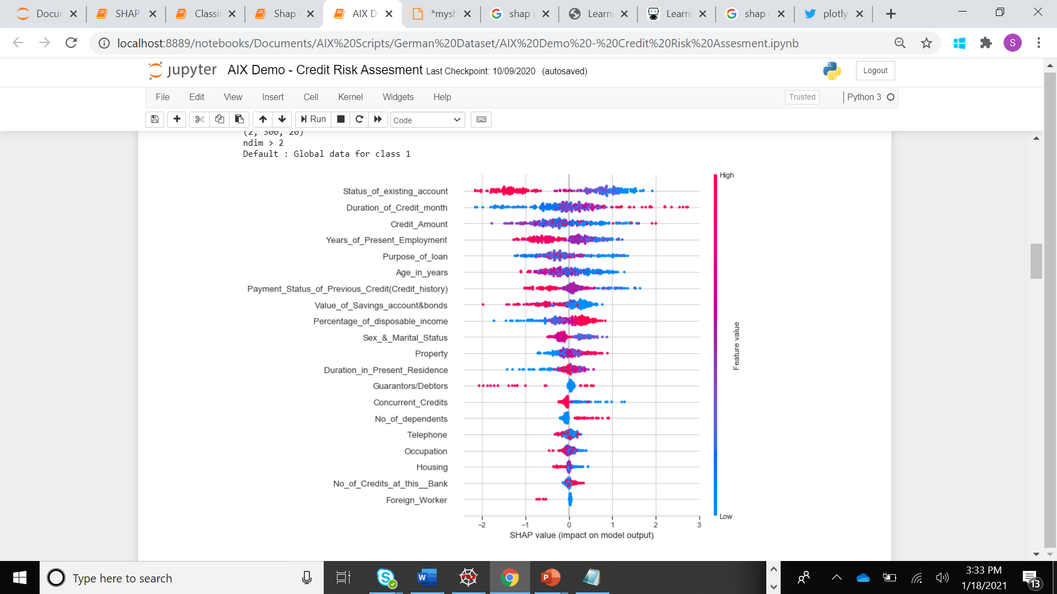
Model Explainer
Summary/Global Feature Importance
Violin Plot/Global Feature Interactions
PDP Plots/Inter feature dependencies
Force Plot/Local Feature Interactions

Slide 8
Model Explainer
Summary/Global Feature Importance
Violin Plot/Global Feature Interactions
PDP Plots/Inter feature dependencies
Force Plot/Local Feature Interactions
Interactions on
Interactions off
Select Feature dropdown
Select Interaction Feature
Credit_Amount
Duration_of_Credit_Mnth
Age_in_years
Marital_Status

Slide 9
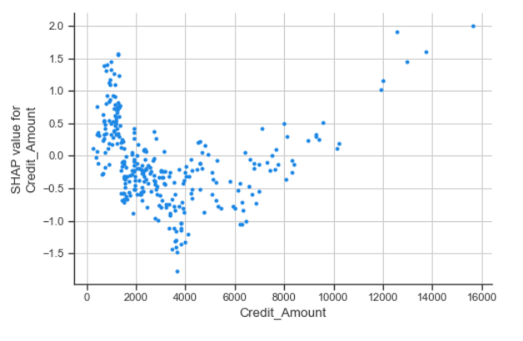
Model Explainer
Summary/Global Feature Importance
Violin Plot/Global Feature Interactions
PDP Plots/Inter feature dependencies
Force Plot/Local Feature Interactions
Interactions on
Interactions off
Credit_Amount
Select Interaction Feature

Slide 10
Model Explainer
Summary/Global Feature Importance
Violin Plot/Global Feature Interactions
PDP Plots/Inter feature dependencies
Force Plot/Local Feature Interactions
Interactions on
Interactions off
Select Feature dropdown
Select Interaction Feature
Credit_Amount
Credit_Amount
Duration_of_Credit_Mnth
Duration_of_Credit_Mnth
Age_in_years
Age_in_years
Marital_Status
Marital_Status

Slide 11
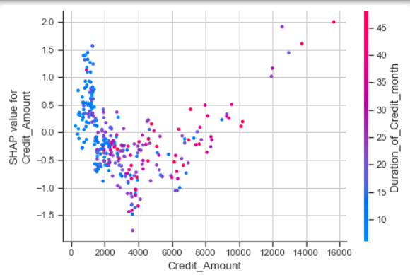
Model Explainer
Summary/Global Feature Importance
Violin Plot/Global Feature Interactions
PDP Plots/Inter feature dependencies
Force Plot/Local Feature Interactions
Interactions on
Interactions off
Credit_Amount
Duration_of_Credit_Mnth

Slide 12
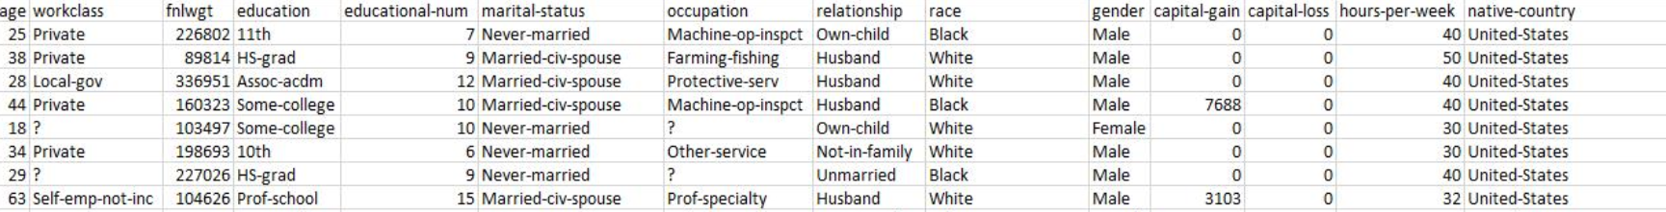
Model Explainer
Summary/Global Feature Importance
Violin Plot/Global Feature Interactions
PDP Plots/Inter feature dependencies
Force Plot/Local Feature Interactions
Workclass
marital_status
Gender
Native-country
Select a data point to check explanation

Slide 13
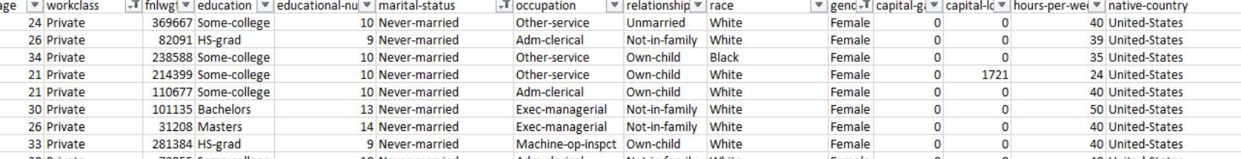
Model Explainer
Summary/Global Feature Importance
Violin Plot/Global Feature Interactions
PDP Plots/Inter feature dependencies
Force Plot/Local Feature Interactions
Workclass = Private
marital_status = Never-married
Gender = Female
Native-country = United-States
Select a data point to check explanation

Slide 14
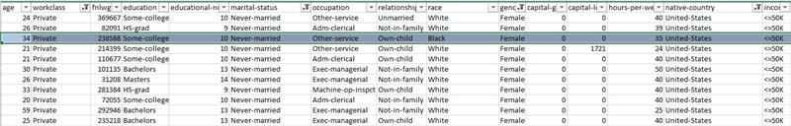
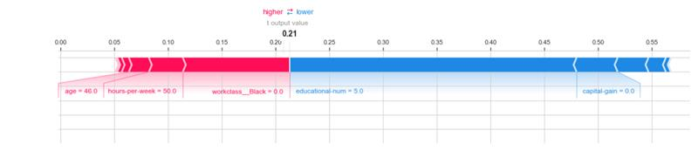
Model Explainer
Summary/Global Feature Importance
Violin Plot/Global Feature Interactions
PDP Plots/Inter feature dependencies
Force Plot/Local Feature Interactions
Workclass = Private
marital_status = Never-married
Gender = Female
Native-country = United-States
Select a data point to check explanation

Slide 15
AIX Tool
Select a module
Model Explainer
Fairness Estimator

Slide 16
Fairness Estimator
Enter the predictor variable
Dropdown
Enter the favorable Class
Dropdown
Enter the sensitive variable
Dropdown
Enter the fairness threshold
Slider/Dropdown

Slide 17
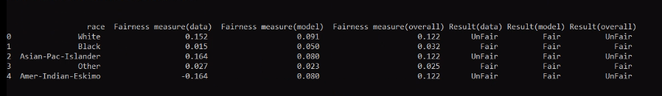
Fairness Estimator
Enter the predictor variable
Income
Enter the favorable Class
>50k
Enter the sensitive variable
Race
Enter the fairness threshold
0.1
Fairness Table

